Slide 1
Client Side Scripting
More on HTML5

Slide 2
Semantic Mark up
<div> and <span> elements are very popular but have the main problem that they give very little meaning to the browser. The browser only knows that content needs to be placed at that part of the browser.
Semantic is defined as the study of meaning of linguistic expressions. In the context of HTML, tags provide meaning to the content in the HTML document.
Semantic HTML is the use of HTML markup to reinforce the semantics (meaning) of the information in webpages rather than defining its presentation.

Slide 3
Importance of Semantic HTML
Communication: Semantic html is an additional layer of communication. Specifically to machines such as feed readers and search engines. In return these machines translate the meaning for people.
Clean: It’s easier to read and edit, which saves time and money during maintenance.
More accessible: It can be better understood by a variety of devices.
Search engine friendly

Slide 4
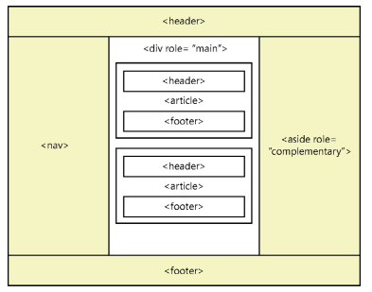
HTML5 Layout Container
A layout container lays out its children in a way that is flexible and reusable.
It uses elements that are meaningful to both the developer and the browser.

Slide 5
HTML5 Layout Container: Elements
<header> Defines a section that provides a header. You can use this element at the top of your HTML document as a page header.
<footer> Defines a section that provides a footer. You can use this element at the bottom of your HTML document as a page footer.
<nav> Defines a section that houses a block of major navigational links.

Slide 6
HTML5 Layout Container: Elements
<aside> Defines a section of content that is separate from the content the <aside> element is in. This is typically used for sidebars.
This has the role attribute where you specify what the content is e.g. application, banner, navigation links.
<section> Part of the whole that is typically named with an <h1> to <h6> element.
<article> A unit of content that can stand on its own and can be copied to other locations. A blog post is a good example of an article.

Slide 7

CSS & HTML Practice
Access Moodle and work out questions 1 and 2 of Worksheet 2

Slide 8
HTML Tables
Tables lay out data in your HTML document in rows and columns
A table displays a two-dimensional grid of data
A basic table can be created by using the <table> element to denote the table
Inside the <table> element, a <tr> element is added to add a new row
Inside each <tr> element, a <td> element is added to add a new cell
The <th> element is used instead of the <td> element to display a header
The header can be horizontal or vertical

Slide 9
HTML Tables
The web browser automatically generates a <tbody> element
This can cause issues when styling. Therefore, it is best to use the <tbody> element yourself instead of letting the browser generating it for you
The <thead> and <tfoot> are also helpful table tags which allow for better organisation and styling

Slide 10
HTML Tables Misuse
HTML tables are powerful and, due to their flexibility, they are often misused.
Over the years, many developers have used the <table> element to create a page layout. Here are some reasons why you should not do such a thing:
The table will not render until the tag has been read. Webpages should be written with semantic markup, and the main element should be as close to the top of the HTML document as possible. The element will render its content as the browser receives it. This enables the user to read the content as it’s being loaded into the browser.
Using a table forces you into a deeply nested HTML structure that is difficult to maintain.
Using a table confuses accessibility devices.
Remember that using a <table> element for anything other than tabular layout of data will be much more difficult to maintain than using <div> elements with positioning.

Slide 11
CSS & HTML Practice
Access Moodle and work out questions 3 to 5 of Worksheet 2

Slide 12
Forms
HTML Forms are used to select different kinds of user input
A form is an area that can contain form elements that allow the user to enter information:
Text fields
Text area fields
Drop-down boxes
Radio buttons
Checkboxes
A form is defined with the <form> tag:
<form>
..
Input elements
..
</form>

Slide 13
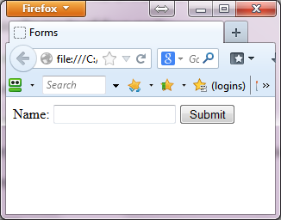
Forms
A form is basically made of four parts:
The <form> tag
Form controls, such as the <input> tag
Labels, which identify the form elements
A trigger, typically a button element, that submits the form
<form>
<label>Name:
<input type="text" name="fullName" />
</label>
<input type="submit" value="Submit" />
</form>

Slide 14
The <input> element
The most used form tag is the <input> tag
The type of input is specified with the type attribute
The most commonly used input types are:
Text Fields – type="text"
Radio Buttons – type="radio"
Check Boxes – type="checkbox"
<input type="text" name="firstname"/>

Slide 15
The Form’s action Attribute
How are the form entries transmitted to the website owner or other designated party?
The action attribute defines the action to be performed when the form is submitted.
Normally, the form data is sent to a web page on the server when the user clicks on the submit button.
Some form of server-side processing is necessary for form data to be delivered properly.
It usually takes the form of a script like Perl that runs on the server natively or installed server applications such as JSP, PHP, .NET, or ColdFusion.
e.g. <form action="myapp/mailForm.jsp">
A URL of another webpage can also be passed to the action attribute.
e.g. <form action=" example.html">

Slide 16
Forms Practice
Access Moodle and work out question 6 to 8 of Worksheet 2

Slide 17
References
Johnson, G. (2013). Programming in HTML5 with Javascript and CSS3. United States of America: Microsoft Press.
Bradley, S. (2011, May 23). How Important Is Semantic HTML? Retrieved from Vanseo Design: http://vanseodesign.com/web-design/semantic-html/

